Slide 1
Navigation Group
Week Two progress

Slide 2
Members update
We resumed the third week with Eucabeth dropping from the project but got Waka joining us.
Updated list of members;
Dennis Bundi.
Charles Otieno.
Kiragu Maina.
Omar Waka.

Slide 3
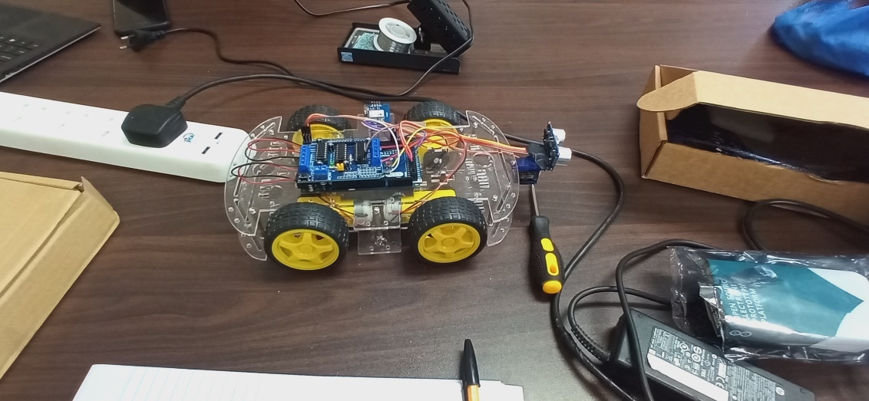
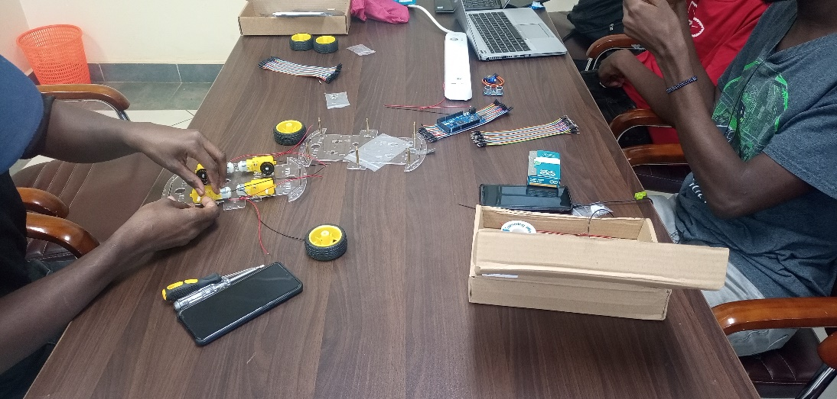
Project test robot assembly
We successfully assembled the test robot and performed tests on the obstacle avoidance course. Uploading of code. And sensor calibration as well as motor driver speed control.

Slide 4
Project Progress
We have successful completed the test robot assembly using obstacle avoidance.
Next will be moving the test robot to a set GPS geo-position.
Design of a stand for a computer vision module and camera.
Design of Acceleration, Braking and Gear shifting actuators.

Slide 5
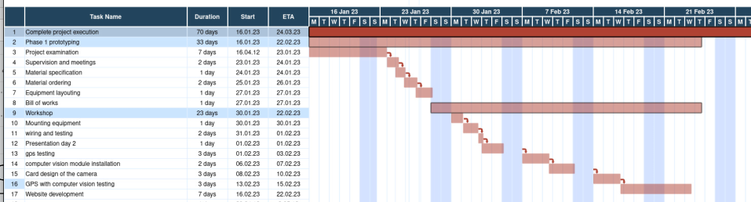
GANTT CHART

Slide 6
Acceleration, Braking and Gear shifting actuators.

Slide 7
Challenges
We could not work with the gps as the magnetometer was missing
We realised the ultrasonic sensor could not work in the area of application.
A more appropriate obstacle detection device would be a camera.
Power. For testing we used a power adapter which limited the robots movement. Rechargeable would be more suited to the task.

Slide 8
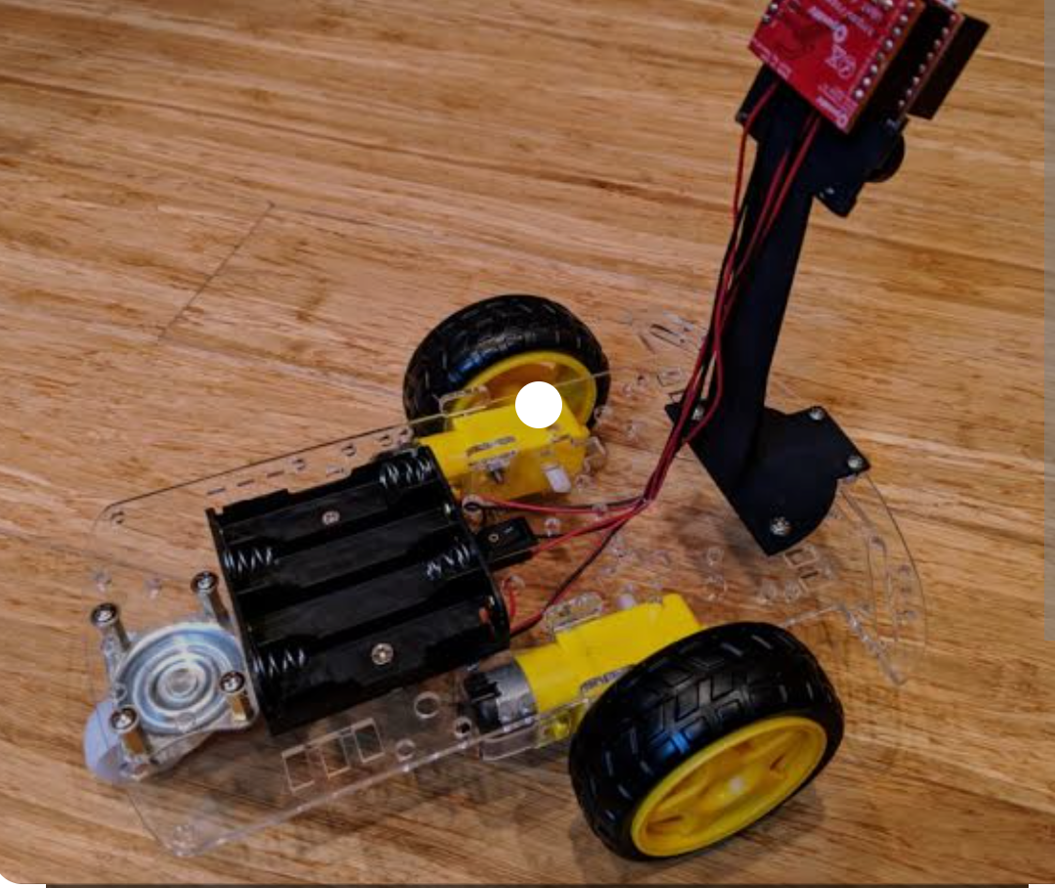
Expected result of the following week.
We expect to include the computer vision after finishing tests on the GPS path finding. Computer vision is a field of artificial intelligence(AI) enabling computers to derive information from image and video inputs.

